Slide 1




PHISHING
HADJA LIBOIRE
https://github.com/571LL01
hadjaliboire

Slide 2
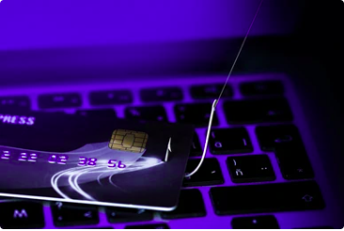
OVERVIEW
01
Introduction
02
Types of Phishing Attacks
03
Detection of Phishing Attacks
04
Prevention of Phishing Attacks
05
What to do in the event of phishing
06
Phishing detection tools
02

Slide 3
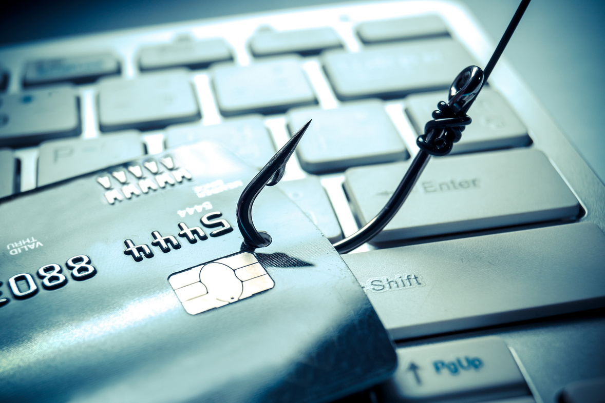
01. INTRODUCTION
Phishing is a fraudulent technique designed to lure Internet users into disclosing personal (access accounts, passwords, etc.) and/or banking data by pretending to be a trusted third party.
Attackers' objective: Pretend to be a trusted third party in order to harvest personal information.
Consequences: data theft, identity theft, major financial losses.
03

Slide 4
02. TYPES OF PHISHING ATTACKS
There are many ways for cybercriminals to execute phishing attacks, but we're going to focus on the 6 most feared.
04

Slide 5
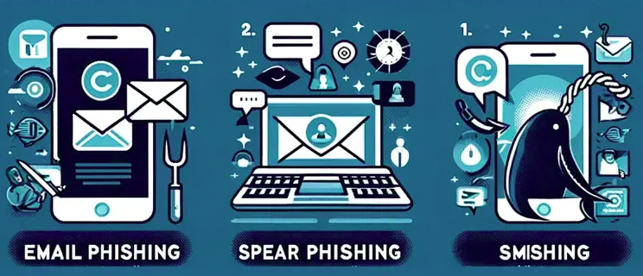
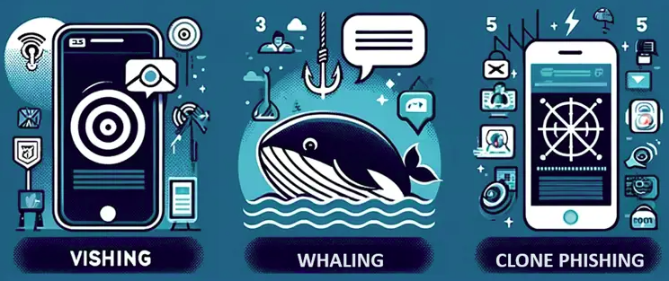
02. Types of Phishing Attacks
05

Slide 6
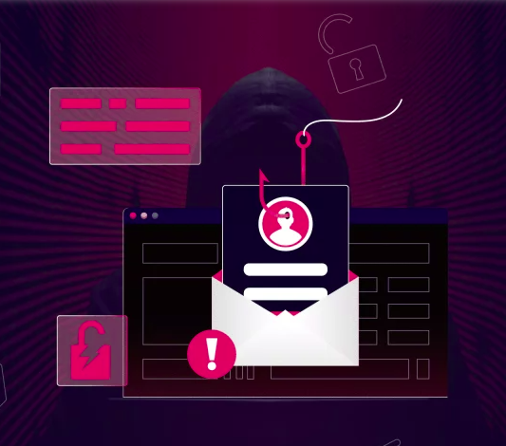
02. Types of Phishing Attacks
EMAIL PHISHING
Cybercriminals send fraudulent emails imitating legitimate companies or institutions to trick victims into clicking on malicious links or providing sensitive information.
Example : A fake bank email requesting account verification.
06

Slide 7
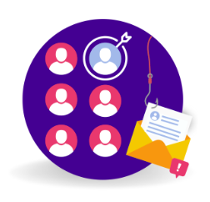
02. Types of Phishing Attacks
SPEAR PHISHING
More targeted attack, aimed at a specific person or organization. Messages are often personalized with real information to increase the credibility and success of the attack.
Example : Email targeting an employee with specific company details.
07

Slide 8
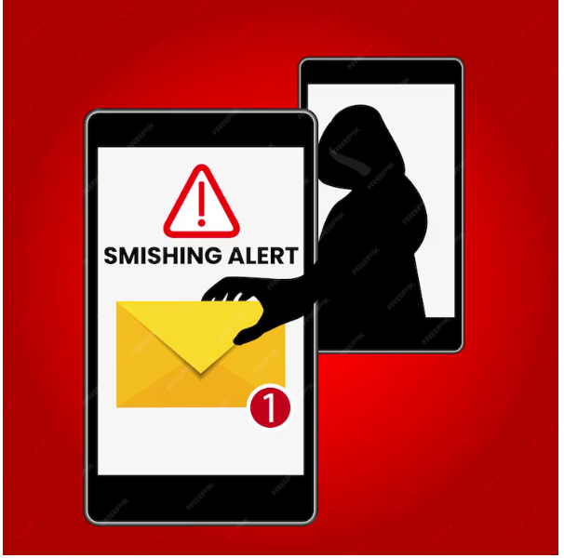
02. Types of Phishing Attacks
SMISHING
Phishing via SMS or text messages. Attackers send messages containing links or call-back numbers to steal personal or financial information.
Example : An SMS claiming you've won a prize and asking you to click on a link.
08

Slide 9
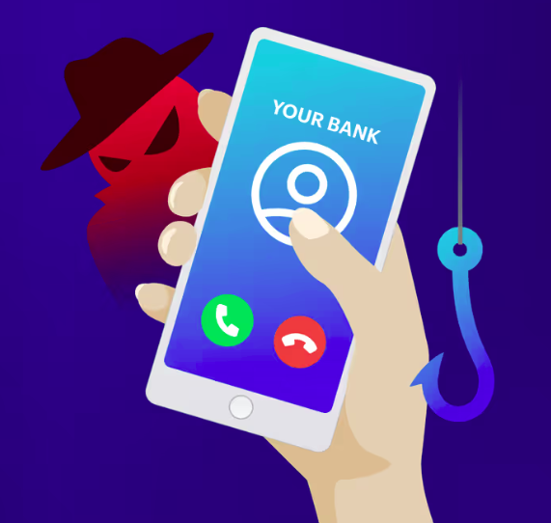
02. Types of Phishing Attacks
VISHING
Vishing, or voice phishing, is a type of phishing attack where scammers use phone calls to trick individuals into revealing personal information, such as passwords or credit card numbers, by pretending to be a legitimate entity.
Example : A telephone conversation in which the attacker poses as a bank officer.
09

Slide 10

02. Types of Phishing Attacks
WHALING
A whaling attack is a sophisticated type of phishing attack specifically aimed at high-profile individuals within an organization, such as executives or senior management.
Example : Fraudulent email sent to the CEO of a company with an urgent request.
10

Slide 11
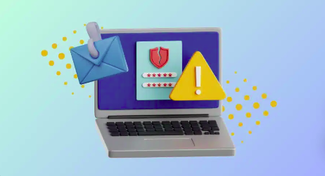
02. Types of Phishing Attacks
CLONE PHISHING
Attackers duplicate a legitimate email, but replace the links or attachments with malicious versions, then resend the email claiming it is an “update” or “patch email”.
Example : A hacker clones a legitimate software update request e-mail sent by the IT department to an employee. The hacker modifies the link to redirect the employee to a malicious site. The employee, thinking the e-mail is genuine, clicks on the link, which may compromise his or her credentials or the organization's security.
11

Slide 12
03. Detection of Phishing Attacks
Suspicious e-mail addresses or numbers
Spelling and grammar errors
There are two types of suspicious sender addresses: misspelled or slightly altered domains, such as “support@bankl.com” instead of “support@bank.com”, are red flags as they are often used to impersonate people or brands, but you should also be wary of generic e-mail addresses from Gmail, Yahoo and Outlook, especially if they don't match who they claim to be.
Email phishing and smishing often contain spelling and grammatical errors, which can be a sign of attack. Despite the use of AI and proofreaders, these errors persist because attackers don't always master their victims' language.This criterion can also apply to Vishing, where the language or tone of the call may appear unusual.
12

Slide 13
03. Detection of Phishing Attacks
Pressure mechanisms: Urgency and threats
Suspicious links and attachments
Phishing attacks exploit pressure mechanisms, such as urgency or threats, to provoke a rapid emotional response. They use tactics such as “Your account will be suspended” to incite immediate action, a common technique in spear phishing, whaling and vishing attacks.
Before clicking, check links by hovering the mouse over them to see if the URL is legitimate. Unusual attachments, especially with unknown extensions, are also red flags.This detection technique applies particularly to Clone Phishing, where links or files are modified.
13

Slide 14
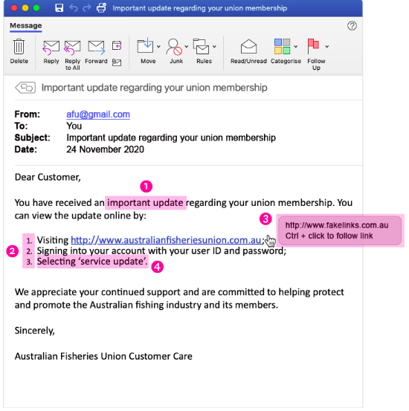
03. Detection of Phishing Attacks
Example
1. It is unexpected or creates a sense of urgency for you to do something.
2. It asks you to click on a link, open an attachment or refers you to a website that asks you to enter your information.
3. The link suggests that it will take you to a legitimate website, but when you hover your mouse over it, it indicates that it's actually another website.
4. It asks for information that the real or legitimate sender doesn't necessarily need to know.
14

Slide 15
04. Prevention of Phishing Attacks
Training and raising awareness among employees and users
Password management and multi-factor authentication (MFA)
Phishing awareness training should combine theory and practice, with simulations to help employees detect and report phishing attempts. It should reinforce detection reflexes, particularly in the face of pressure mechanisms, and teach reporting procedures to alert potential threats. Hands-on learning is essential for changing behavior in the face of social engineering attacks.
To protect against phishing, two key practices are recommended: using a password manager to create and store unique passwords, and enabling multi-factor authentication (MFA) to add an extra layer of security. Together, these measures strengthen account protection and reduce the risk of compromise.
15

Slide 16
04. Prevention of Phishing Attacks
Use spam filters and security software :
Do not click on links or attachments
Activate a phishing filter in your inbox and use up-to-date security software to block fraudulent e-mails before they reach your inbox.
This helps prevent mainly Email Phishing and Clone Phishing attacks.
It is essential never to click on links or open attachments from suspicious e-mails or SMS messages. Always check the sender before acting, even if the e-mail seems legitimate, as a crucial preventive measure against phishing attacks,
16

Slide 17
05. What to do in the event of phishing
If you think you've received a phishing e-mail, here are the steps to follow. You can also share this process with your employees, if you don't already have one in place.
Don't interact with the phishing e-mail: don't reply, click on links or execute attachments.
Report the phishing attempt to the appropriate parties, using a report button if applicable.
If you have interacted with the phishing e-mail and its contents, explain what you have done to the parties concerned so that they can trace and possibly remedy any leaks or vulnerabilities introduced.
17

Slide 18
06. phishing detection tools
Microsoft Defender for Office 365, Proofpoint and Barracuda Essentials are widely used email security solutions that include phishing detection features.
URLScan.io and VirusTotal allow users to inspect suspicious links without visiting them directly.
Avast Online Security , Bitdefender TrafficLight and Norton Safe Web, they analyze web pages in real time and warn users of potential phishing risks.
18

Slide 19
REFERENCES
https://www.fortinet.com/resources/cyberglossary/types-of-phishing-attacks
https://www.strongboxit.com/what-are-the-types-of-phishing-attacks/
https://www.ba-info.fr/spear-phishing-comprendre-et-prevenir-ces-attaques-devastatrices/
https://arsen.co/en/resources/phishing
https://arsen.co/en/blog/phishing-detection
19

Slide 20
THANK YOU

